Slide 1
How to Access
E-RESUME

Slide 2
How to Access: E-RESUME
(1) Login to Tams Service Deck and enter your Student Number and Password.
Student Number
Password

Slide 3
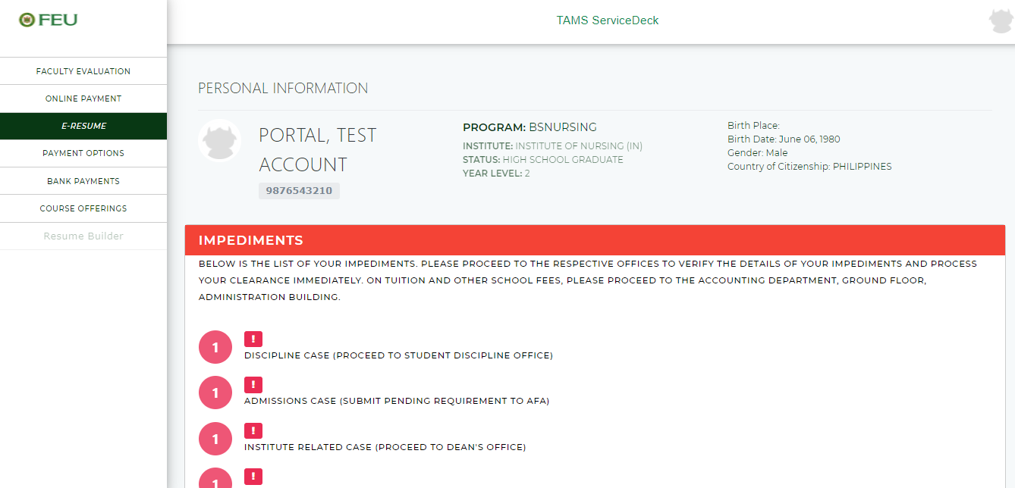
How to Access: E-RESUME
(2) Once logged on, Click the E-Resume button.

Slide 4
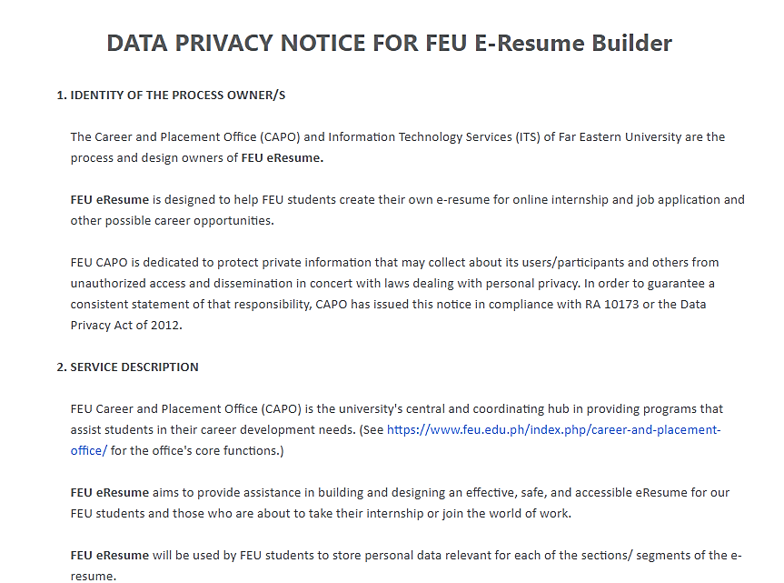
How to Access: E-RESUME
(3) Read carefully the policy and tick the check box to agree. Then, click proceed button.

Slide 5
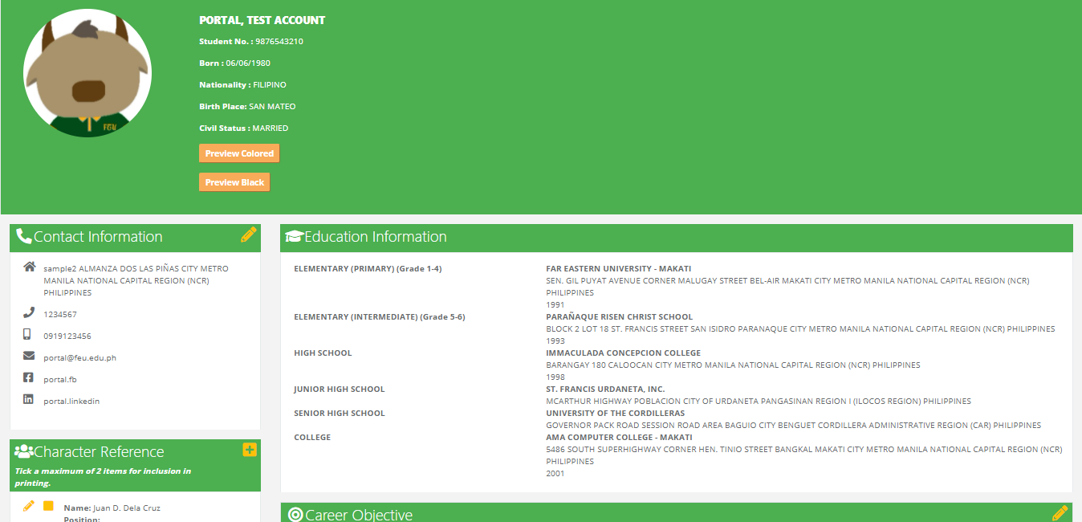
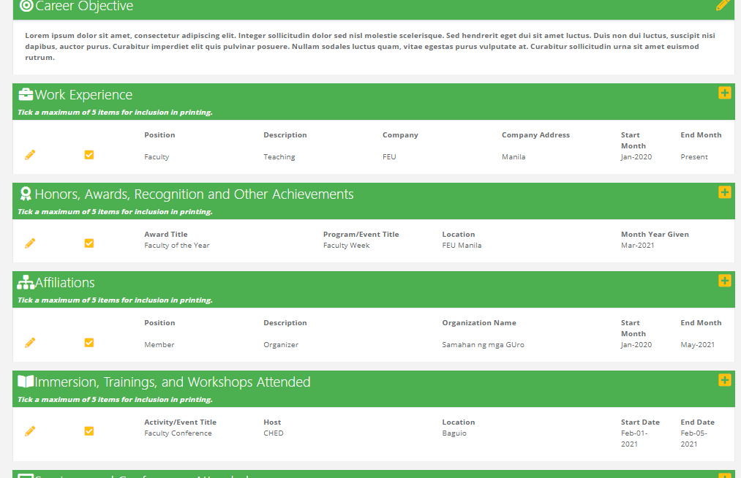
How to Access: E-RESUME
(4) Fill up all the necessary information to your E-Resume.

Slide 6
How to Access: E-Resume
(5) After completing your E-Resume, you may view it by clicking Preview Colored (colored) or

Slide 7
How to Access: E-Resume
(6) After completing your E-Resume, you may view it by clicking Preview Black (black & white)

Slide 8
How to Access: E-RESUME
(7) To have your copy, you may send it to your official FEU email account by clicking Send Copy to Email.

Slide 9
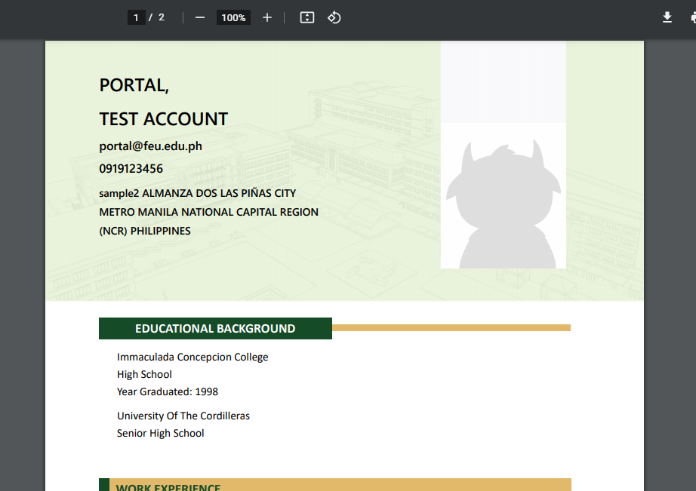
How to Access: E-Resume
(8) You will receive an email of your E-Resume copy.

