Slide 1
How to..
Update Vaccination Status
Take the Survey
Complete your Policy Agreements
Update your Student Records

Slide 2
Tams Service Deck
(1) Log in to your Tams Service Deck using your Student Number and Password.
Student Number
Password

Slide 3
Vaccination Status/Survey
(2) Click Proceed to Update button to update your CoVid vaccine (1st and 2nd Dose). Kindly disregard if you’re fully vaccinated already.
(3) Click Proceed to Survey button to take the survey on the Limited Face to Face Classes.
Proceed to Update

Slide 4
Policy Agreements
(4) To read the Data Privacy Policy and its Consent Form, Statement and Undertaking on Membership in Accredited Organizations, Statement and Undertaking on New Policies, and Consent and Waiver for the Policy on Drugs , click Continue.

Slide 5
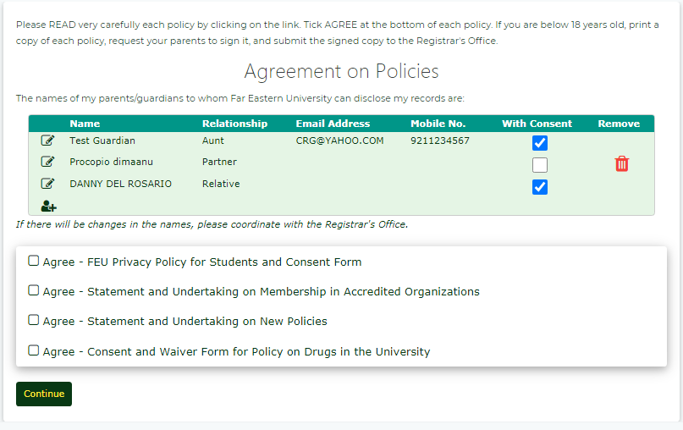
Policy Agreements
(5) Enter the information of parent/guardian to whom your FEU records may be disclosed. Otherwise, leave blank.
(6) Click each link below to view the policy statement.

Slide 6
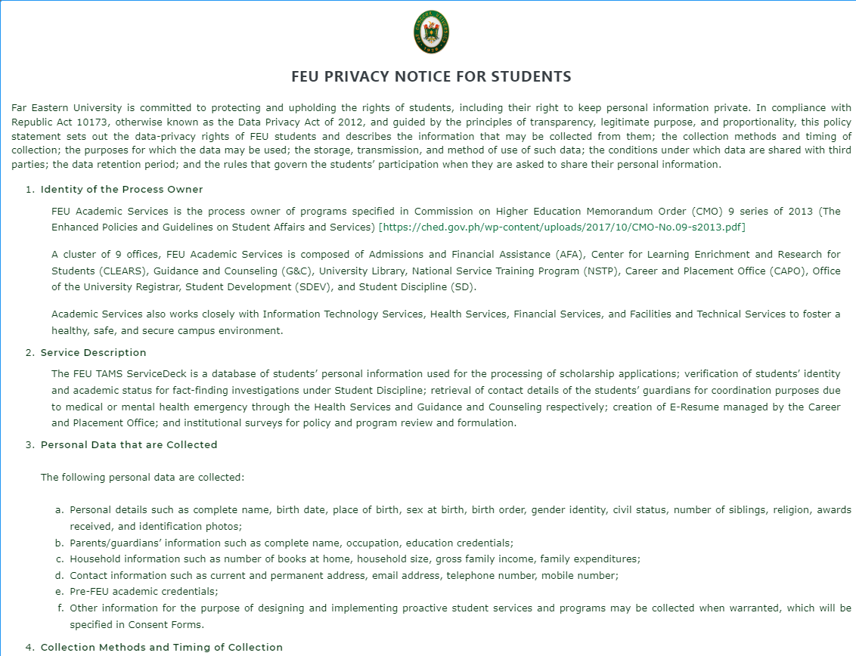
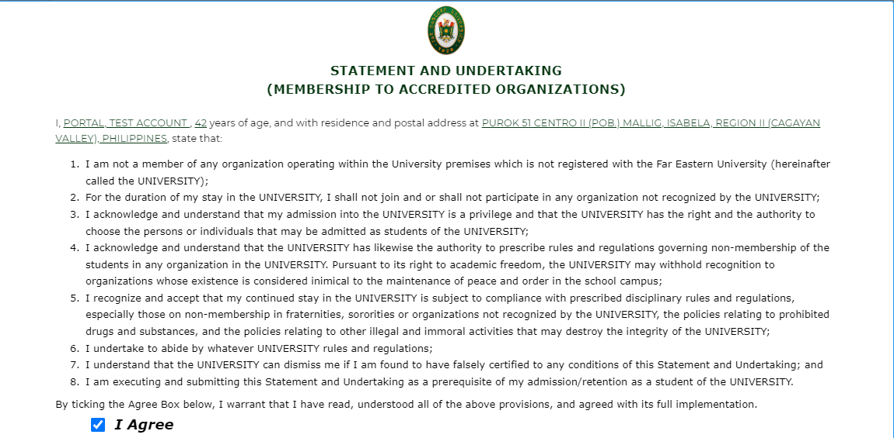
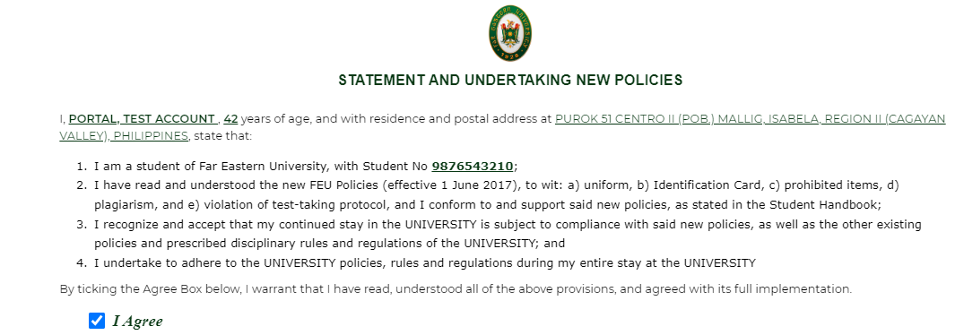
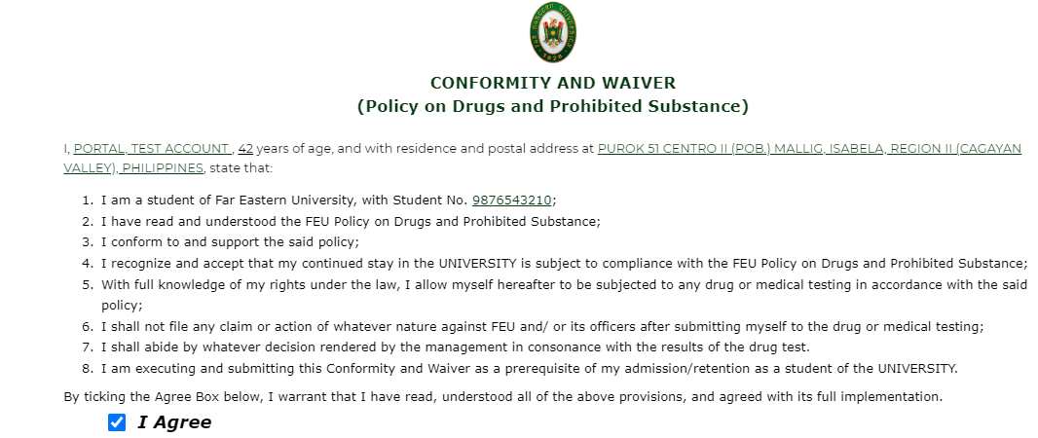
Policy Agreements
(7) Read carefully each policy and tick Agree at the bottom. Click Close.
1
2
3
4

Slide 7
Update Student Records
(8) To update your student records, click Update Now.

Slide 8
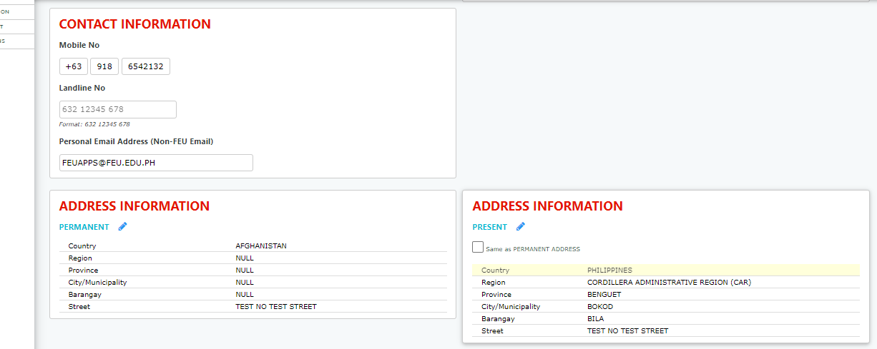
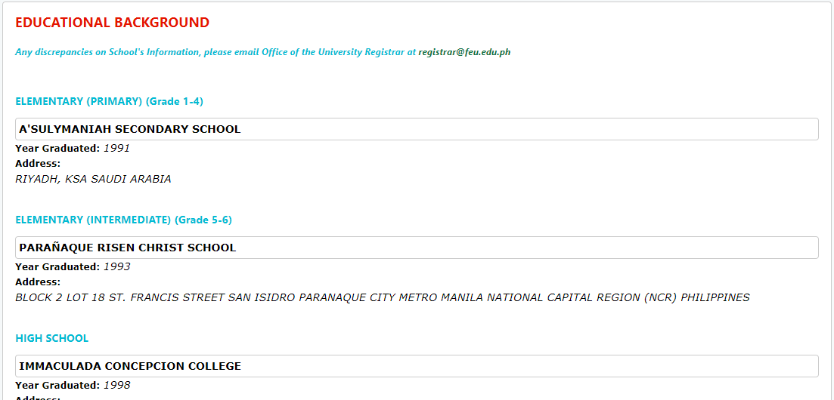
Update Student Records
(9) Select and edit the information (if any).

